Slide 1
DATA WAREHOUSING
By
Syed Bakhtawar Shah Abid
Assistant Professor
Department of Computer Science
Data Warehousing

Slide 2
DATA MART
Means different things to different people
A scaled-down version of a data warehouse that is tailored to contain only information likely to be used by the target group
The data mart is directed at a partition of data (often called a subject area) that is created for the use of a dedicated group of users
A data mart might in fact be a set of denormalized, summarized or aggregated data sometime placed on the DW database.
Data Warehousing

Slide 3
DATA MART
A data mart is a snapshot of operational data from one or many sources that facilitates analysis of trends and comparisons of data
A data mart is designed to support decision making over a well defined set of topics
A data mart is meant to serve one or two departments rather than the entire enterprise
Data Warehousing

Slide 4
The Need for Data Marts
Operational systems are built to serve day-to-day administrative tasks
  Enrollment
  Service Authorization
  Billing
Often designed without considering management reporting needs
Operational systems emphasize availability of current data over historical data
Data Warehousing

Slide 5
The Need for Data Marts
Data marts are optimized for analyzing the data recorded by other systems
Data marts can merge data from different systems (and different organizations) for comparison and cross-referencing
Data marts focus on a historical data perspective that allows data from different time periods to be compared
Data Warehousing

Slide 6
Data Mart
A data mart does not replace the operational reporting provided by source systems, which provide an up-to-the-minute picture of operations
Several data marts may coexist within the enterprise, each with a different purpose
A data mart is intended as an investigatory tool rather than a means to get everyday business done
Data Warehousing

Slide 7
DATA MART
The business drivers underlying such developments include
  Extremely urgent user requirements
  The absence of a budget for a full DW strategy
  The absence of a sponsor for an enterprise wide decision support strategy
  The decentralization of business units
  The attraction of easy-to-use tools and a mind-sized projects
Data Warehousing

Slide 8
ETL
In a DWH project, 50% of the work is related to ETL.
ETL stands for
  E: Extract from the operational system
  T: Transform the data, which includes data cleansing
  L: Loading the data into the DWH
Some people call it ETML i.e. Extract Transform Move Load, as you have to move the data into the DWH.
There is a significant part after data transformation that involves data cleansing i.e. there is a C also here.
However, ETL is a pretty standard definition, and normally when you say ETL people know what you mean.
Data Warehousing

Slide 9
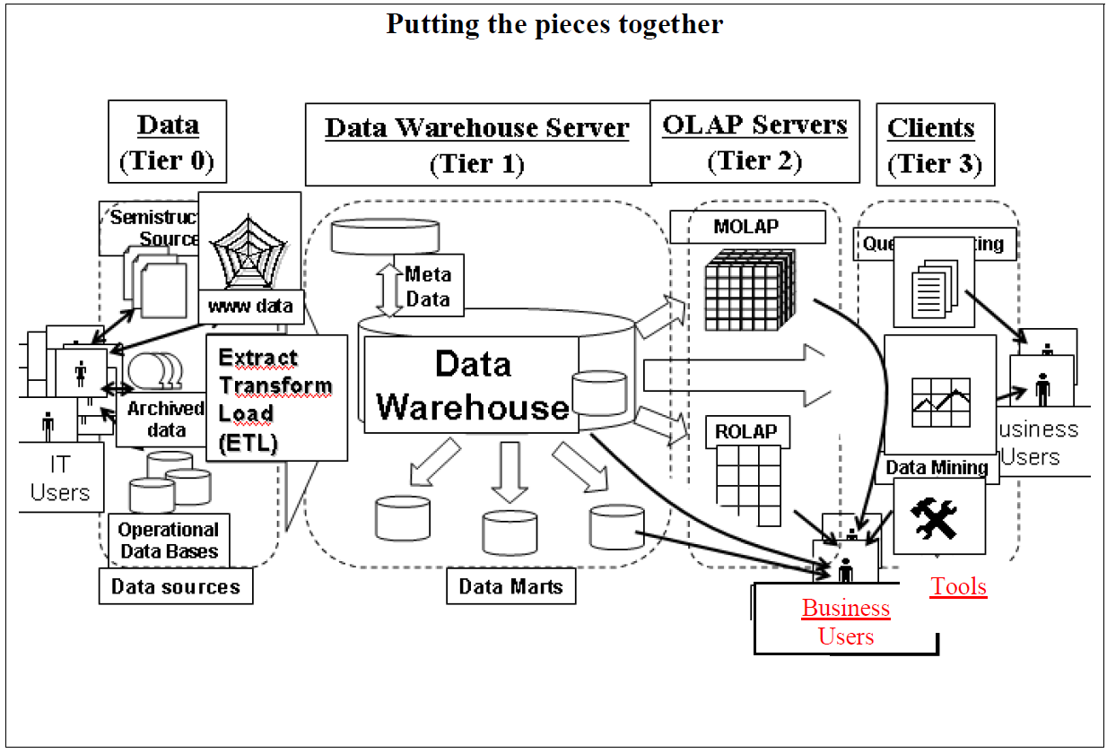
ETL
Data Warehousing

Slide 10
ETL
The above figure shows a multi-tiered data warehousing architecture.
We can see that at the lowest level (tier 0) lies the data sources like operational, archived and/or web etc.
Data Warehouse Server lays in the next level (tier 1).
We can see in the above figure that ETL box lies at the boundaries of both the tiers 0 and 1.
That means it serves as a bridge between data source systems and the actual data warehouse.
Thus the source data is processed using some set of activities before bringing it into the data warehouse environment.
These set of activities comprise the ETL process.
Data Warehousing

Slide 11
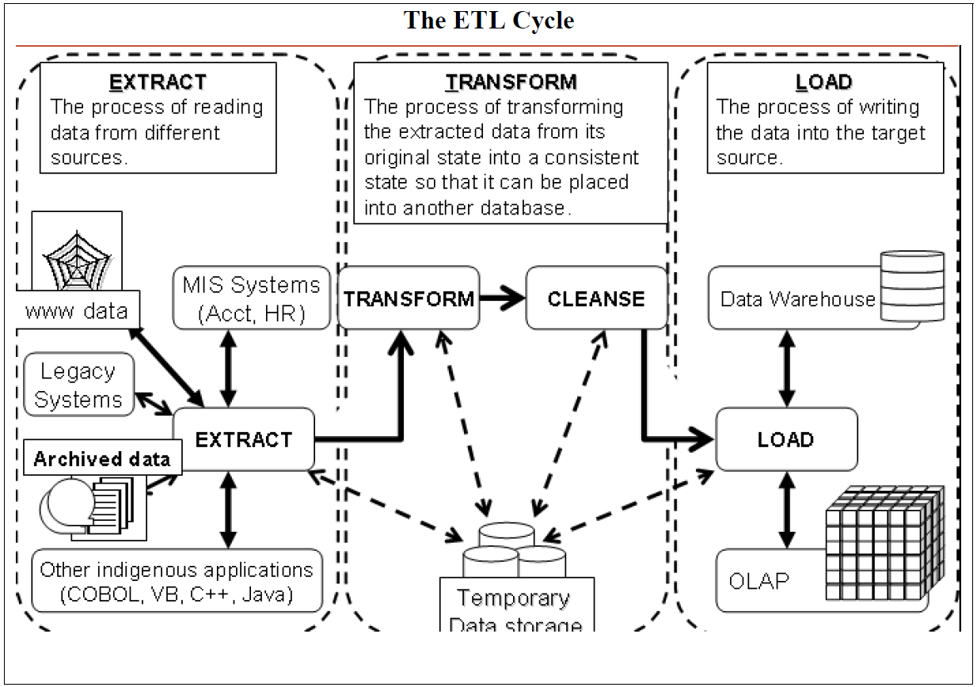
ETL
Data Warehousing

Slide 12
The ETL Cycle
As shown in the above figure, ETL process consists of three major activities separated by dotted lines.
  The first step is the Extract which is the activity of reading data from multiple heterogeneous data sources.
  Next comes the Transform step which is the activity of transforming the input data from multiple heterogeneous environments into a single consistent state.
  Another important activity at this level is the data cleansing which is the activity of noise removal from input data before bringing it in the DWH environment.
  The final step is the Load which is an activity of loading cleansed data in to the target system.
Data Warehousing

Slide 13
Challenges in ETL functions
ETL functions are challenging primarily because of the nature of the source systems.
Most of the challenges in ETL arise from the disparities among the source operational systems.
  Source systems are very diverse and disparate.
  There is usually a need to deal with source systems on multiple platforms and different operating systems.
  Many source systems are older legacy applications running on obsolete database technologies.
Data Warehousing

Slide 14
Challenges in ETL functions
  Generally, historical data on changes in values are not preserved in source operational systems.
  Historical information is critical in a data warehouse.
  Quality of data is dubious in many old source systems that have evolved over time.
  Source system structures keep changing over time because of new business conditions.
    ETL functions must also be modified accordingly.
  Gross lack of consistency among source systems is commonly prevalent.
    Same data is likely to be represented differently in the various source systems.
    For example, data on salary may be represented as monthly salary, weekly salary, and bimonthly salary in different source payroll systems.
Data Warehousing

Slide 15
Challenges in ETL functions
  Even when inconsistent data is detected among disparate source systems, lack of a means for resolving mismatches escalates the problem of inconsistency.
  Most source systems do not represent data in types or formats that are meaningful to the users.
    Many representations are cryptic and ambiguous.
Data Warehousing

Slide 16
ETL is Time-Consuming and Laborious
When the project team designs the ETL functions, tests the various processes, and deploys them, you will find that these consume a very high percentage of the total project effort.
It is not uncommon for a project team to spend as much as 50–70% of the project effort on ETL functions.
You have already noted several factors that add to the complexity of the ETL functions.
Data Warehousing

Slide 17
ETL is Time-Consuming and Laborious
Data extraction itself can be quite involved depending on the nature and complexity of the source systems.
The metadata on the source systems must contain information on every database and every data structure that are needed from the source systems.
We need very detailed information, including database size and volatility of the data.
We have to know the time window during each day when you can extract data without impacting the usage of the operational systems.
We also need to determine the mechanism for capturing the changes to data in each of the relevant source systems.
These are active and time consuming activities.
Data Warehousing

Slide 18
ETL is Time-Consuming and Laborious
Activities within the data transformation function can run the range of transformation methods.
You have to
  Reformat internal data structures,
  Re-sequence data,
  Apply various forms of conversion techniques,
  Supply default values wherever values are missing, and
  you must design the whole set of aggregates that are needed for performance improvement.
In many cases, you need to convert from EBCDIC to ASCII formats.
Data Warehousing

Slide 19
ETL is Time-Consuming and Laborious
Now turn your attention to the data loading function.
The sheer massive size of the initial loading can populate millions of rows in the data warehouse database.
Creating and managing load images for such large numbers are not easy tasks.
Even more difficult is the task of testing and applying the load images to actually populate the physical files in the data warehouse.
Sometimes, it may take two or more weeks to complete the initial physical loading.
Data Warehousing

Slide 20
ETL Requirements and Steps
The following list enumerates the types of activities and tasks that compose the ETL process.
This list is by no means complete for every data warehouse, but it gives a good insight into what is involved to complete the ETL process.
Data Warehousing

Slide 21
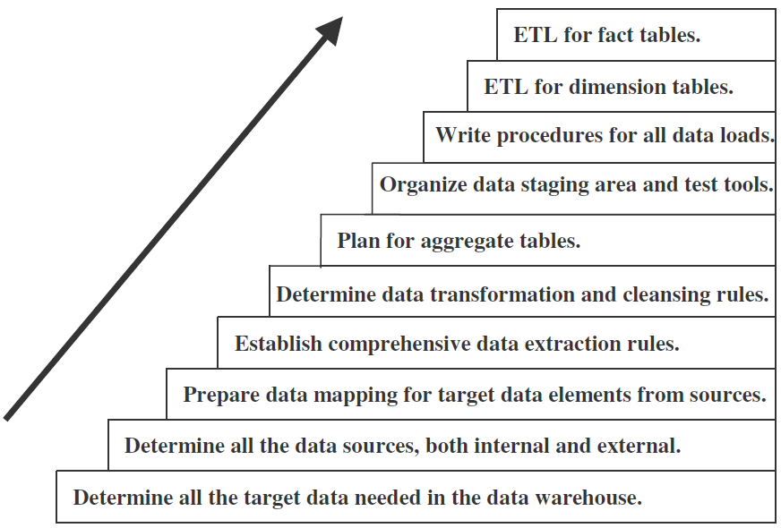
ETL Requirements and Steps
Data Warehousing

Slide 22
ETL Requirements and Steps
Combine several source data structures into a single row in the target database of the data warehouse.
Split one source data structure into several structures to go into several rows of the target database.
Read data from data dictionaries and catalogs of source systems.
Read data from a variety of file structures including flat files, indexed files (VSAM), and legacy system databases (hierarchical/network).
Load details for populating atomic fact tables.
Aggregate for populating aggregate or summary fact tables.
Transform data from one format in the source platform to another format in the target platform.
Derive target values for input fields (example: age from date of birth).
Change cryptic values to values meaningful to the users (example: 1 and 2 to male and female).
Data Warehousing

Slide 23
DATA EXTRACTION
Two major factors differentiate the data extraction for a new operational system from the data extraction for a data warehouse.
  First, for a data warehouse, you have to extract data from many disparate sources.
  Next, for a data warehouse, you have to extract data on the changes for ongoing incremental loads as well as for a one-time initial full load.
Data Warehousing

Slide 24
DATA EXTRACTION
Effective data extraction is a key to the success of your data warehouse.
Therefore, you need to pay special attention to the issues and formulate a data extraction strategy for your data warehouse.
Here is a list of data extraction issues:
  Source Identification
  Method of extraction (manual or tool-based)
  Extraction frequency
  Time window (time for extraction process)
  Job sequencing (determine whether the beginning of one job in an extraction job stream has to wait until the previous job has finished successfully)
  Exception handling (determine how to handle input records that cannot be extracted)
Data Warehousing

Slide 25
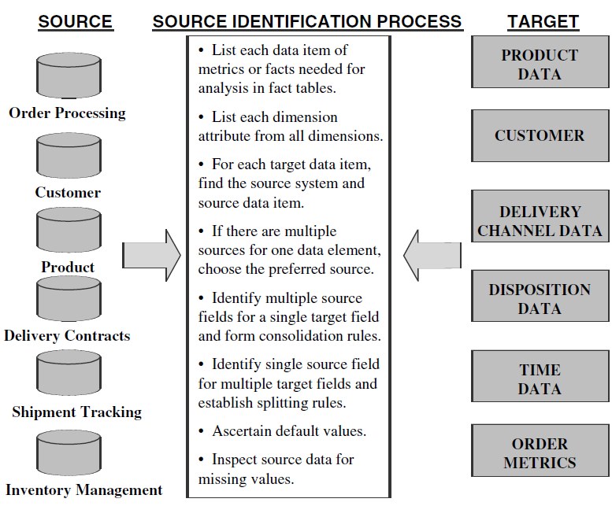
SOURCE IDENTIFICATION: A STEPWISE APPROACH
Data Warehousing

Slide 26
DATA TRANSFORMATION
The extracted data is raw data and it cannot be applied to the data warehouse.
First, all the extracted data must be made usable in the data warehouse.
Having information that is usable for strategic decision making is the underlying principle of the data warehouse.
Data Warehousing

Slide 27
DATA TRANSFORMATION
You know that the data in the operational systems is not usable for this purpose.
Next, because operational data is extracted from many old legacy systems, the quality of the data in those systems is less likely to be good enough for the data ware house.
You have to enrich and improve the quality of the data before it could be usable in the data warehouse.
Data Warehousing

Slide 28
DATA TRANSFORMATION
Before moving the extracted data from the source systems into the data warehouse, you inevitably have to perform various kinds of data transformations.
You have to transform the data according to standards because they come from many dissimilar source systems.
You have to ensure that after all the data is put together, the combined data does not violate any business rules.
Data Warehousing

Slide 29
DATA TRANSFORMATION
Consider the data structures and data elements that you need in your data warehouse.
Now think about all the relevant data to be extracted from the source systems.
From the variety of source data formats, data values, and the condition of the data quality, you know that you have to perform several types of transformations to make the source data suitable for your data warehouse.
Transformation of source data encompasses a wide variety of manipulations to change all the extracted source data into usable information to be stored in the data warehouse.
Data Warehousing

Slide 30
Data Transformation: Basic Tasks
Irrespective of the variety and complexity of the source operational systems, and regardless of the extent of your data warehouse, you will find that most of your data transformation functions break down into a few basic tasks.
Let us go over these basic tasks so that you can view data transformation from a fundamental perspective.
Data Warehousing

Slide 31
DATA TRANSFORMATION
Here is the set of basic tasks:
  Selection.
    Selection of either whole records or parts of several records from the source systems .
  Splitting/joining.
    This task includes the types of data manipulation you need to perform on the selected parts of source records.
  Conversion.
    This is an all-inclusive task. It includes a large variety of basic conversions of single fields for two primary reasons
      One to standardize among the data extractions from disparate source systems, and
      The other to make the fields usable and understandable to the users.
Data Warehousing

Slide 32
DATA TRANSFORMATION
  Summarization.
    Sometimes you may find that it is not feasible to keep data at the lowest level of detail in your data warehouse.
    It may be that none of your users ever need data at the lowest granularity for analysis or querying.
  Enrichment.
    This task is the rearrangement and simplification of individual fields to make them more useful for the data warehouse environment.
    You may use one or more fields from the same input record to create a better view of the data for the data warehouse.
    This principle is extended when one or more fields originate from multiple records, resulting in a single field for the data warehouse.
Data Warehousing

Slide 33
Major Transformation Types
The most common transformation types are:
  Format Revisions.
    These revisions include changes to the data types and lengths of individual fields.
  Decoding of Fields.
    When you deal with multiple source systems, you are bound to have the same data items described by a plethora of field values.
    The classic example is the coding for gender, with one source system using 1 and 2 for male and female and another system using M and F.
Data Warehousing

Slide 34
Major Transformation Types
  Calculated and Derived Values.
    What if you want to keep profit margin along with sales and cost amounts in your data warehouse tables?
    The extracted data from the sales system contains sales amounts, sales units, and operating cost estimates by product.
    You will have to calculate the total cost and the profit margin before data can be stored in the data warehouse.
    Average daily balances and operating ratios are examples of derived fields.
Data Warehousing

Slide 35
Major Transformation Types
  Splitting of Single Fields.
    Earlier legacy systems stored names and addresses of customers and employees in large text fields.
    The first name, middle initials, and last name were stored as a large text in a single field.
    Similarly, some earlier systems stored city, state, and Zip Code data together in a single field.
  Merging of Information.
    Data collected from multiple sources must be merged for a single entity before loading into DWH.
Data Warehousing

Slide 36
Major Transformation Types
  Character Set Conversion.
    This type of data transformation relates to the conversion of character sets to an agreed standard character set for textual data in the data warehouse.
    If you have mainframe legacy systems as source systems, the source data from these systems will be in EBCDIC characters.
    If PC-based architecture is the choice for your data warehouse, then you must convert the mainframe EBCDIC format to the ASCII format.
Data Warehousing

Slide 37
Major Transformation Types
  Conversion of Units of Measurements.
    Many companies today have global branches.
    Measurements in many European countries are in metric units.
    If your company has overseas operations, you may have to convert the metrics so that the numbers may all be in one standard unit of measurement.
  Date/Time Conversion.
    This type relates to representation of date and time in standard formats.
    For example, the American and the British date formats may be standardized to an international format.
Data Warehousing

Slide 38
Major Transformation Types
  Summarization.
    This type of transformation is the creating of summaries to be loaded in the data warehouse instead of loading the most granular level of data.
  Key Restructuring.
    While extracting data from your input sources, look at the primary keys of the extracted records.
    You will have to come up with keys for the fact and dimension tables based on the keys in the extracted records.
  Deduplication.
    In many companies, the customer files have several records for the same customer.
    Employee files and, sometimes, product master files have this kind of duplication problem.
Data Warehousing

Slide 39
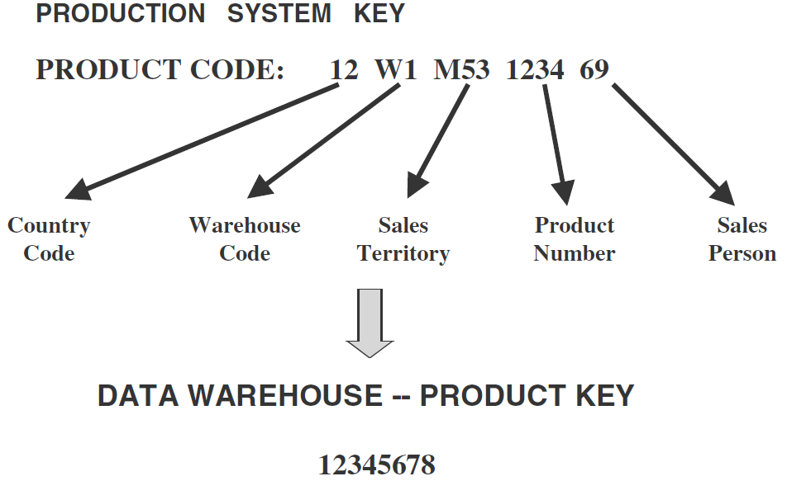
Data Integration and Consolidation
Data Warehousing

Slide 40
Data Integration and Consolidation
The real challenge of ETL functions is the pulling together of all the source data from many disparate, dissimilar source systems.
As of today, most the data warehouses get data extracted from a combination of
  Legacy mainframe systems,
  Old minicomputer applications, and
  Some newer client/server systems.
Most of these source systems do not conform to the same set of business rules.
Very often they follow different naming conventions and varied standards for data representation.
Data Warehousing

Slide 41
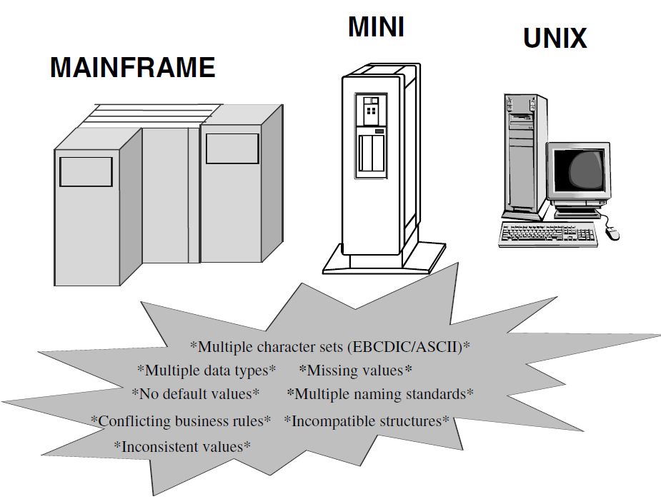
Data Integration and Consolidation
Data Warehousing

Slide 42
Data Integration and Consolidation
Integrating the data is the combining of all the relevant operational data into coherent data structures to be made ready for loading into the data warehouse.
You may want to think of data integration and consolidation as a type of preprocess before other major transformation routines are applied.
You have to standardize the names and data representations and resolve discrepancies in the ways in which same data is represented in different source systems.
Although time-consuming, many of the data integration tasks can be managed.
Data Warehousing

Slide 43
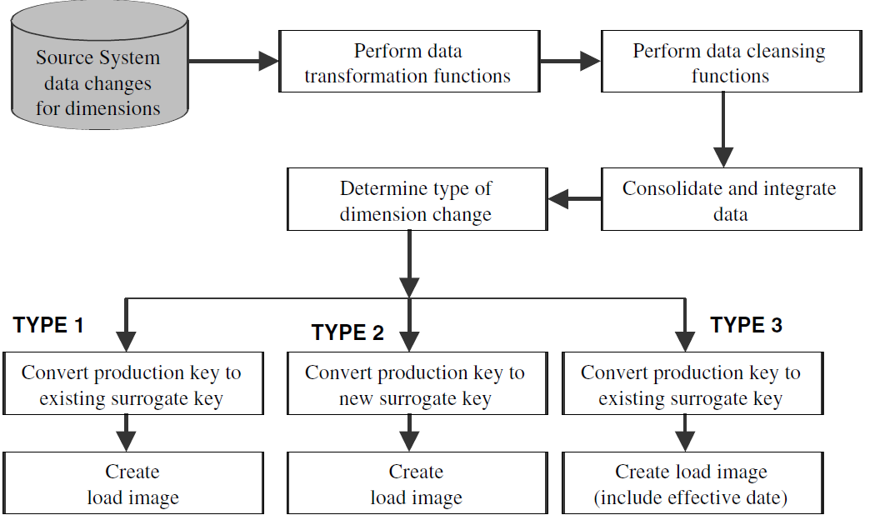
Implementing Transformation
Data Warehousing

Slide 44
DATA LOADING
It is generally agreed that transformation functions end as soon as load images are created.
The next major set of functions consists of the ones that take the prepared data, apply it to the data warehouse, and store it in the database there.
You create load images to correspond to the target files to be loaded in the data warehouse database.
The whole process of moving data into the data warehouse repository is referred to in several ways.
You must have heard the phrases applying the data, loading the data, and refreshing the data.
Data Warehousing

Slide 45
DATA LOADING
For the sake of clarity we will use the phrases as indicated below:
  Initial Load
    Populating all the data warehouse tables for the very first time
  Incremental Load
    Applying ongoing changes as necessary in a periodic manner
  Full Refresh
    Completely erasing the contents of one or more tables and reloading with fresh data (initial load is a refresh of all the tables)
Data Warehousing

Slide 46
DATA LOADING
Because loading the data warehouse may take an inordinate amount of time, loads are generally cause for great concern.
During the loads, the data warehouse has to be offline.
You need to find a window of time when the loads may be scheduled without affecting your data warehouse users.
Data Warehousing

Slide 47
DATA LOADING
Therefore, consider dividing up the whole load process into smaller chunks and populating a few files at a time.
This will give you two benefits.
  You may be able to run the smaller loads in parallel. Also,
  You might be able to keep some parts of the data warehouse up and running while loading the other parts.
Data Warehousing

Slide 48
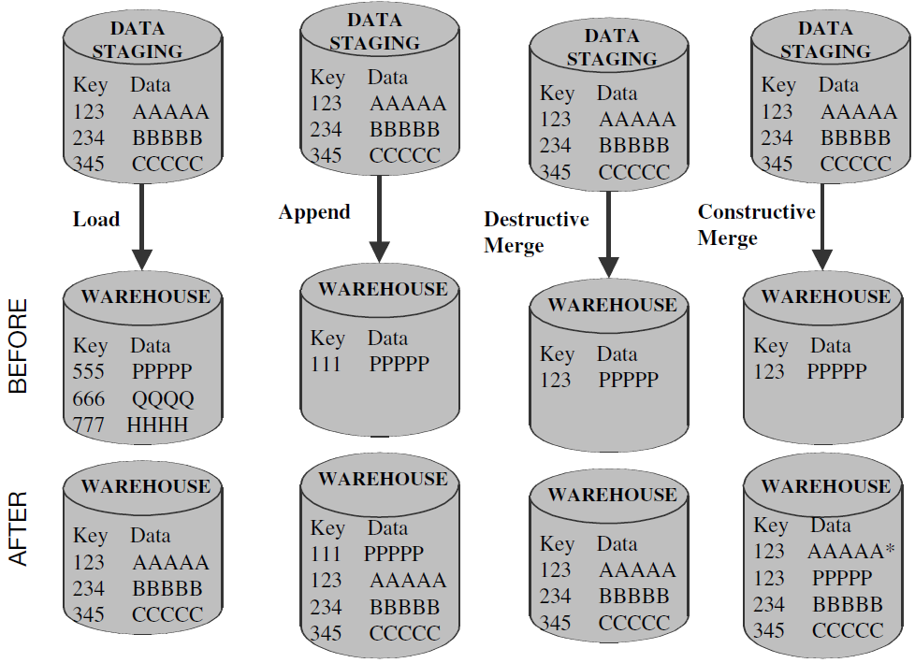
Applying Data: Techniques and Processes
Data Warehousing

Slide 49
Applying Data: Techniques and Processes
Load.
  If the target table to be loaded already exists and data exists in the table, the load process wipes out the existing data and applies the data from the incoming file.
  If the table is already empty before loading, the load process simply applies the data from the incoming file.
Append.
  You may think of the append as an extension of the load.
  If data already exists in the table, the append process unconditionally adds the incoming data, preserving the existing data in the target table.
  When an incoming record is a duplicate of an already existing record, you may define how to handle an incoming duplicate.
  The incoming record may be allowed to be added as a duplicate.
  In the other option, the incoming duplicate record may be rejected during the append process.
Data Warehousing

Slide 50
Applying Data: Techniques and Processes
Destructive Merge.
  In this mode, you apply the incoming data to the target data.
  If the primary key of an incoming record matches with the key of an existing record, update the matching target record.
  If the incoming record is a new record without a match with any existing record, add the incoming record to the target table.
Constructive Merge.
  This mode is slightly different from the destructive merge.
  If the primary key of an incoming record matches with the key of an existing record, leave the existing record, add the incoming record, and mark the added record as superseding the old record.
Data Warehousing

Slide 51
Data Refresh Versus Update
After the initial load, you may maintain the data warehouse and keep it up-to-date by using two methods:
  Update
    Application of incremental changes in the data sources
  Refresh
    Complete reload at specified intervals
Technically, refresh is a much simpler option than update.
To use the update option, you have to devise the proper strategy to extract the changes from each data source.
Then you have to determine the best strategy to apply the changes to the data warehouse.
Data Warehousing

Slide 52
Data Refresh Versus Update
The refresh option simply involves the periodic replacement of complete data warehouse tables.
But refresh jobs can take a long time to run.
If you have to run refresh jobs every day, you may have to keep the data warehouse down for unacceptably long times.
The case worsens if your database has large tables.
Data Warehousing

Slide 53
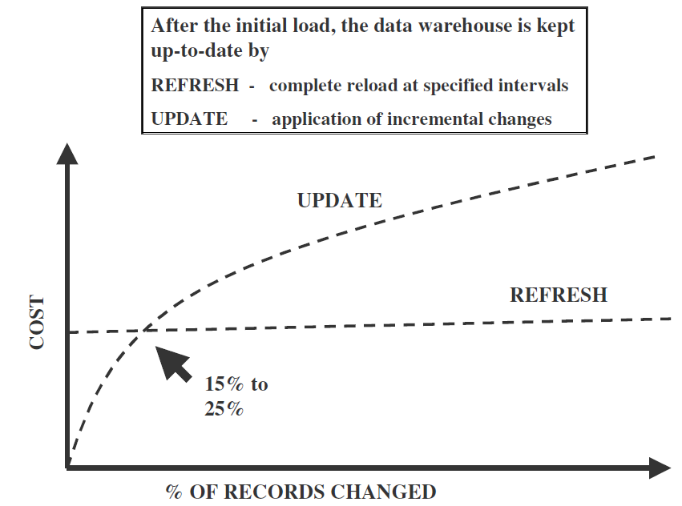
Data Refresh Versus Update
Data Warehousing

